Slide 1
Portfolio Assignments for Project: Java and Web Development PJWD01
https://github.com/annabanananana/recipe-app
By Anna Jansen von Havighorst Tutor: Christian Remfert IU For the degree of Bachelor of Science in Computer Science

Slide 2
Purpose of the app
Maintain a digital cook book
Add recipes to a data base
Search for recipes in the data base that use certain ingredients

Slide 3
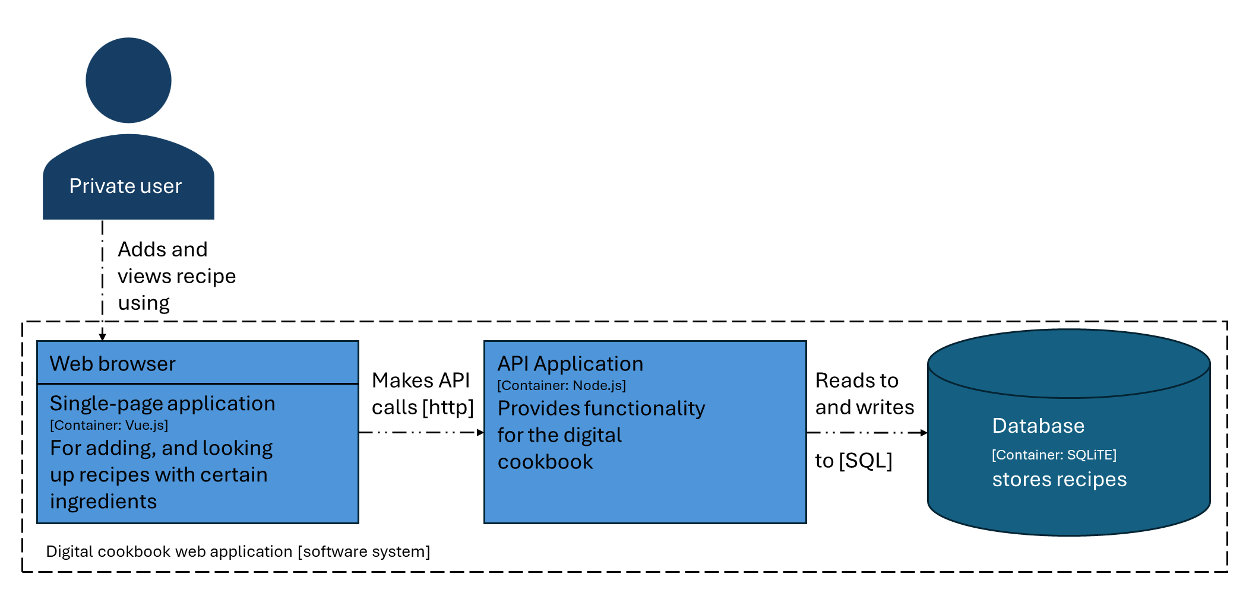
Architecture Diagram

Slide 4
Overview of technology choices
Used technologies for developing the app:
Vue.js
SQLite for database storing the recipes
Node.js

Slide 5
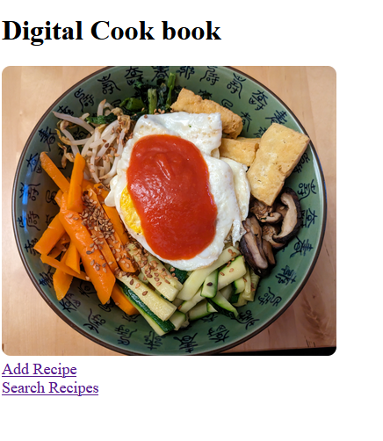
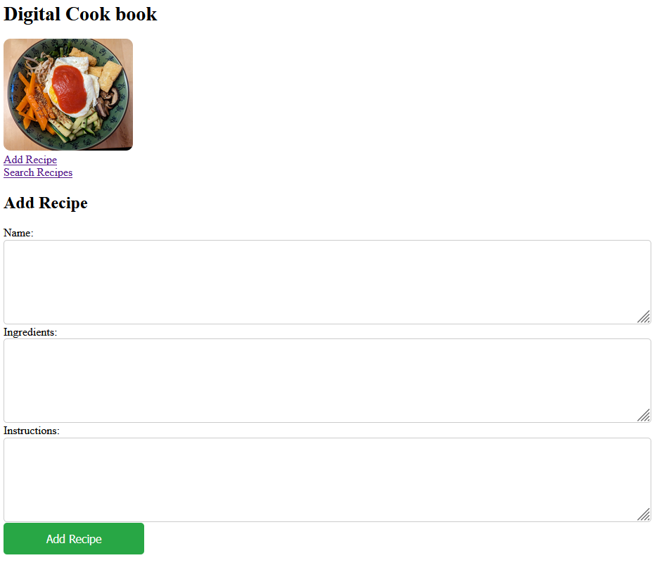
Starting page of the recipe app
Action | Expected Outcome
 | You are directed to the ‚Add recipe‘ page which shows a blank form with name, ingredients and instructions.
Click on the Add Recipe
link

Slide 6
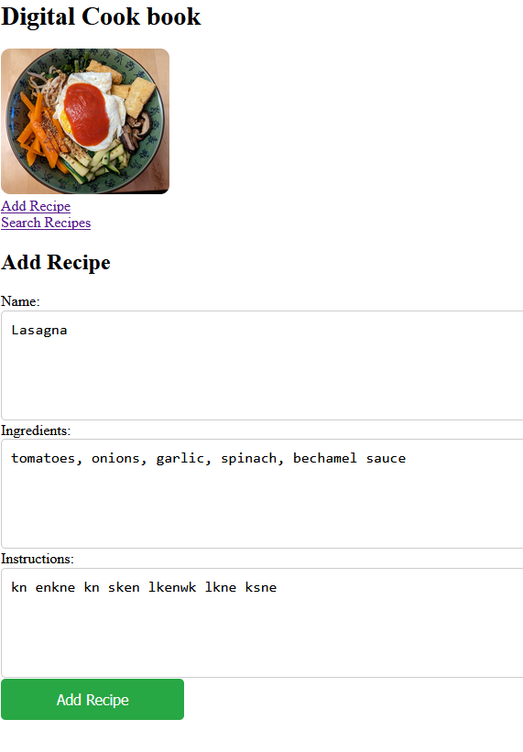
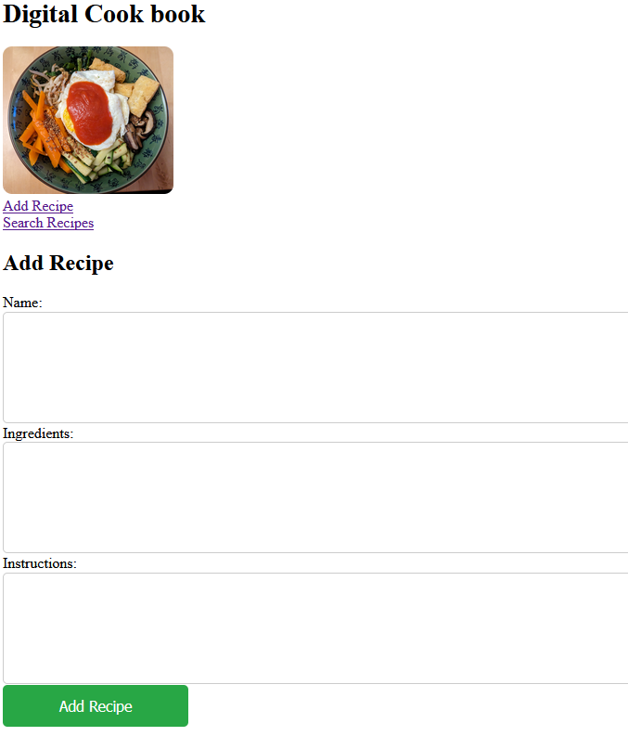
Adding a recipe to the data base
Action | Expected Outcome
 | After clicking on the ‚Add Recipe‘ button the recipe is added to the database and the form is cleared. Now the form can be filled again and another recipe can be added to the data base.
1. Fill out the text areas
‚Name‘, ‚Ingredients‘,
and ‚Instructions‘
2. Click the ‚Add Recipe‘
button

Slide 7
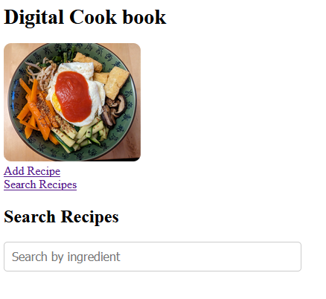
Starting page of the recipe app
Action | Expected Outcome
 | You are directed to the ‚Search Recipes‘ page which shows a text field where one can search recipes by ingredients.
Click on the Search Recipes
link

Slide 8
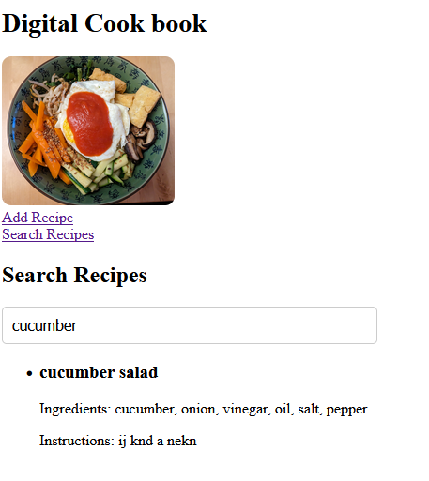
Searching for a recipe in the data base
Action | Expected Outcome
 | You are shown all recipes which use the ingredient. Be sure you enter a complete ingredient.
Type in an ingredient in the text area which you want to use

Slide 9
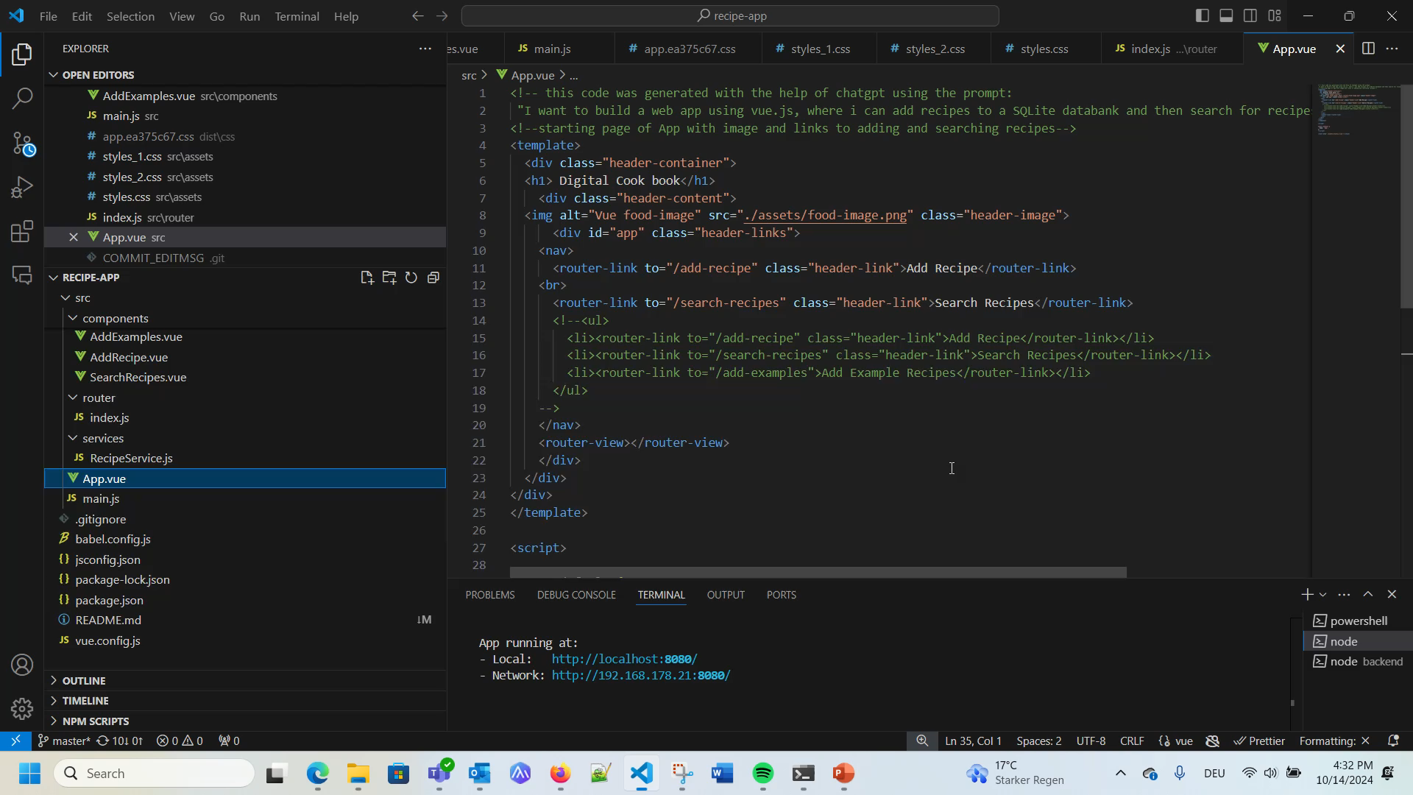
Video running the app

